Slide 1
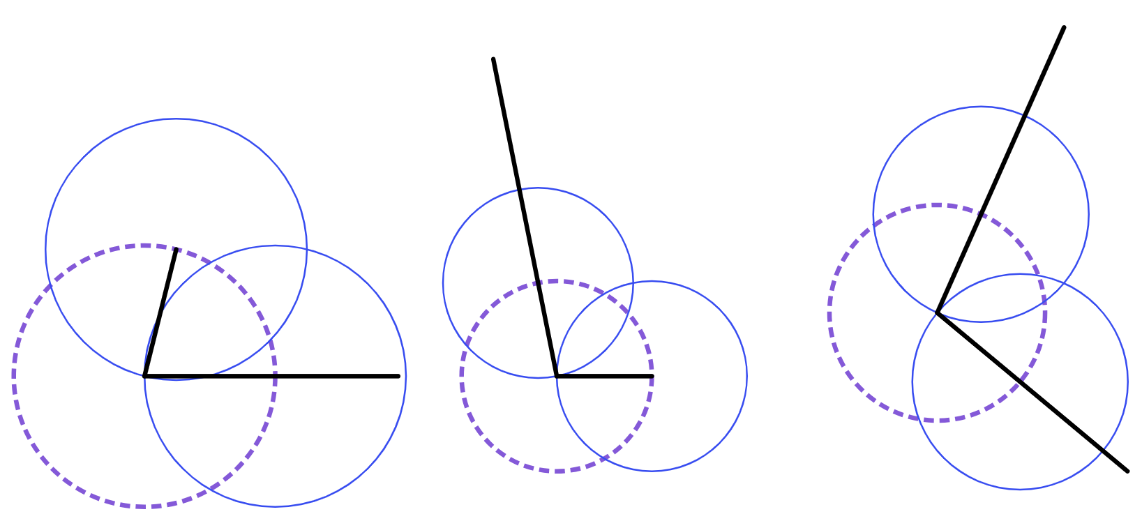
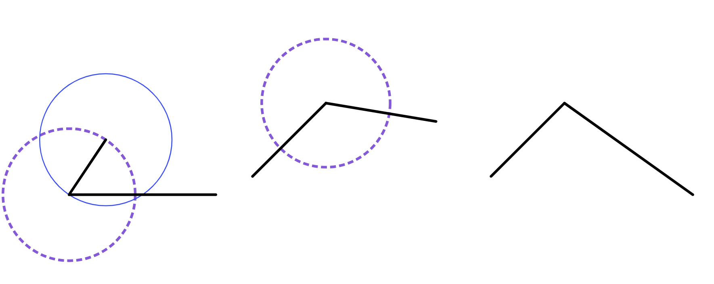
Bisecting an angle
1) Complete each construction to draw a rhombus.
rhombus A
rhombus B
rhombus C
rhombus B
2) Complete each construction to draw a rhombus.
rhombus A
rhombus C
Using a protractor, measure the opposite angles of each rhombus. If each pair of opposite angles are the same size, then your construction is accurate!

Slide 2
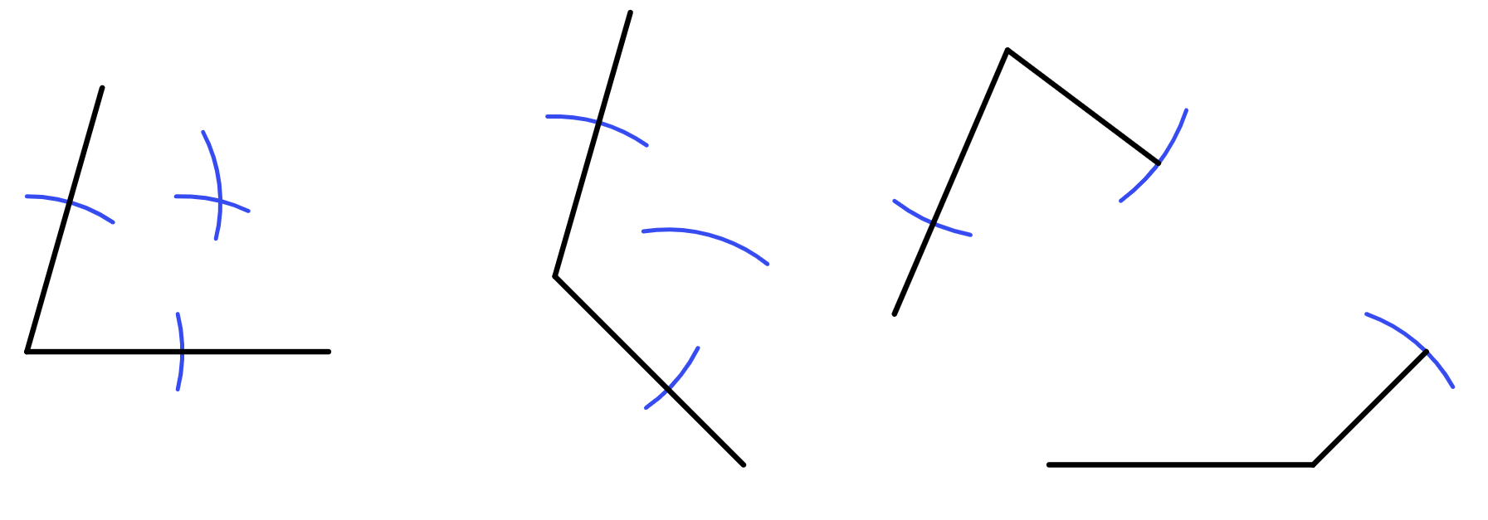
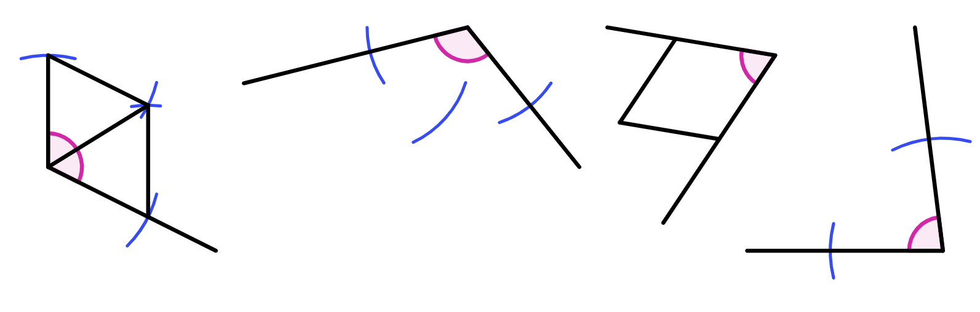
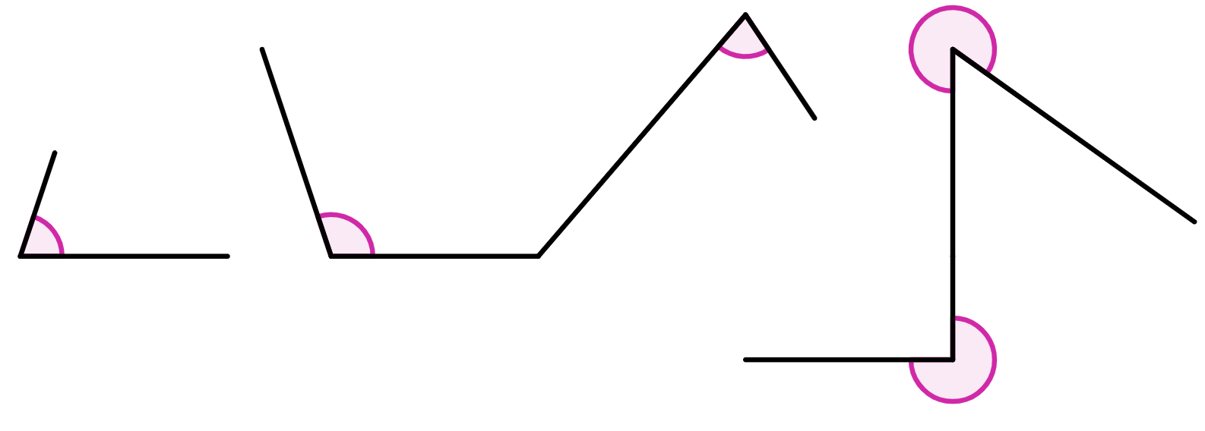
Bisecting an angle
Task B: Efficient construction of a rhombus
1) By only drawing arcs and straight lines, complete the construction of each rhombus.
rhombus A
rhombus B
rhombus C
rhombus D
Task C: Bisecting an angle using rhombi constructions
1) These constructions show partially drawn angle bisectors.
a) Using a protractor, measure the acute or obtuse angle.
b) Complete each construction.
c) Using a protractor, measure the bisected angle and check it is half the original angle.
117° and 58.5°
angle bisector D
83° and 41.5°
angle bisector B
66° and 33°
115° and 57.5°
angle bisector C
angle bisector A
2) Bisect each of the given angles, and measure the size of the bisected angle.
a)
b)
bisected angle of 37°.
c)
bisected angle of 153°.
bisected angle of 36°.
bisected angle of 54°.
bisected angle of 135°.
Mathematics in Education and Industry.
v2.3

